Slide 1



Slide 2
Our services One stop solution to offset printing and packaging .
PACKAGING :
Mono Cartons
Master Cartons
Sheet form Labels
Sheet form Stickers
PROMOTIONAL MEDIA :
Catalogs
Brochures
Leaflets
Poster
Banners
Wobblers
Danglers
Shelf strips
Shopping paper bags

Slide 3




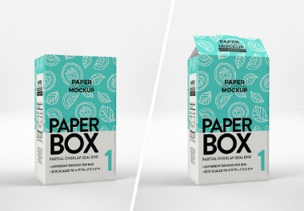

Mono Cartons:

Slide 4

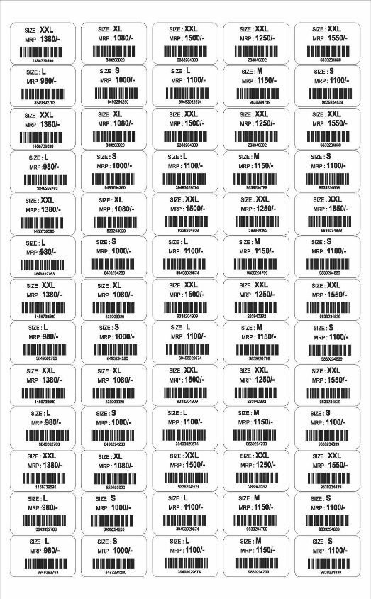



Labels/ Barcodes/ Tags:

Slide 5


Shopping paper bags:

Slide 6



Marketing collateral:

Slide 7



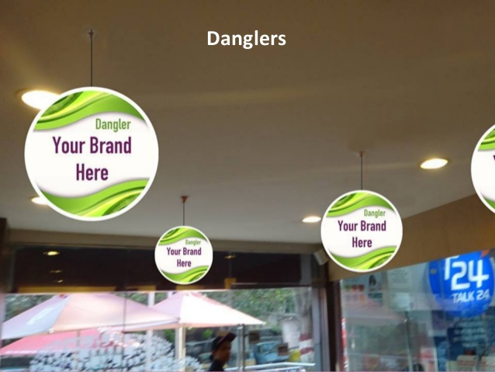

Point Of Sale :

Slide 8

Contact us :
GSTIN : 29ASWPS8245H1ZP
PAN No. : ASWPS8245H
Phone : +91 8049584922
Mobile : +91 9845476106
Email Id : harish@customprintingco.com
Website : www.customprintingco.com

